Slide 1
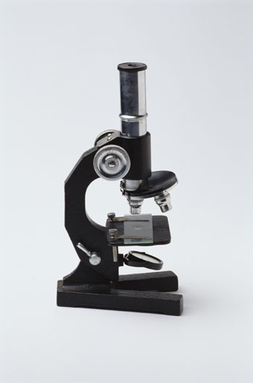
Documenting Sources:
Using APA Format
A workshop brought to you by the Purdue University
Writing Lab
Purdue University Writing Lab
Notes:
Rationale: Welcome to “Documenting Sources: Using APA Format.” This presentation is designed to introduce your students to the purposes of documentation, as well as methods for effectively using parenthetical citations and a reference page. The twenty-three slides presented here are designed to aid the facilitator in an interactive presentation of strategies for using APA style. This presentation is ideal for the beginning of a research unit in a science course or any assignment that requires APA documentation.
This presentation may be supplemented with OWL handouts, including “Using APA Format.” (http://owl.english.purdue.edu/handouts/research/r_apa.html), “Paraphrase: Write It in Your Own Words” (http://owl.english.purdue.edu/handouts/research/r_paraphr.html), “Quoting, Paraphrasing, and Summarizing” (http://owl.english.purdue.edu/handouts/research/r_quotprsum.html), and “Avoiding Plagiarism” (http://owl.english.purdue.edu/handouts/research/r_plagiar.html).
Directions: Each slide is activated by a single mouse click, unless otherwise noted in bold at the bottom of each notes page.
Writer and Designer: Jennifer Liethen Kunka
Contributors: Muriel Harris, Karen Bishop, Bryan Kopp, Matthew Mooney, David Neyhart, and Andrew Kunka
Developed with resources courtesy of the Purdue University Writing Lab
Grant funding courtesy of the Multimedia Instructional Development Center at Purdue University
© Copyright Purdue University, 2000
Updated September 2001 by Geoff Stacks

Slide 2

Why Use APA Format?
Allows readers to cross-reference your sources easily
Provides consistent format within a discipline
Gives you credibility as a writer
Protects yourself from plagiarism
Purdue University Writing Lab
Notes:
Key Concepts: This slide allows the facilitator to explain the purposes for using APA documentation. APA documentation style is commonly utilized for research in science-related fields, as opposed to MLA style, which is used for research in the liberal arts. APA format provides writers with a format for cross-referencing their sources--from their parenthetical references to their reference page. This cross-referencing system allows readers to locate the publication information of source material. This is of great value for researchers who may want to locate your sources for their own research projects. The proper use of APA style also shows the credibility of writers; such writers show accountability to their source material. Most importantly, use of APA style can protect writers from plagiarism--the purposeful or accidental use of source material by other writers without giving appropriate credit. The next slide provides additional information on plagiarism.
Click to reveal each item.

Slide 3

Cross-Referencing Your Sources
Cross-referencing allows readers to locate the publication information of source material. This is of great value for researchers who may want to locate your sources for their own research projects.
Purdue University Writing Lab
Notes:
This slide explains the importance of cross-reference your sources.
It may be helpful to discuss this in terms of a community. Writers of research papers enter a community of reseachers by sharing the sources they’ve found.

Slide 4

Using a Consistent Format
Using a consistent format helps your reader understand your arguments and the sources they’re built on.
It also helps you keep track of your sources as you build arguments.
Purdue University Writing Lab
Notes:
Using APA properly will allow you to communicate more effectively with other researchers who also use APA. When a style is used consistently, others can easily find where you’ve listed your resources.

Slide 5

Establishing Credibility
The proper use of APA style shows the credibility of writers; such writers show accountability to their source material.
Purdue University Writing Lab
Notes:
This slide explains how using APA can establish your credibility as a researcher.

Slide 6

Avoiding Plagiarism
Proper citation of your sources in APA style can help you avoid plagiarism, which is a serious offense. It may result in anything from failure of the assignment to expulsion from school.
Purdue University Writing Lab
Notes:
Key Concepts: Plagiarism is a serious offense in the university system, and may result in punishments ranging from failure of the assignment, failure of the course, or expulsion from school.
There is a handout on OWL about plagiarism and can be found at http://owl.english.purdue.edu/workshops/hypertext/ResearchW/plag.html
Click to reveal each item.

Slide 7

Where Do I Find APA Format?
Publication Manual of the American Psychological Association, 5th ed.
www.apastyle.org
Composition textbooks
OWL website: owl.english.purdue.edu
Writing Lab Grammar Hotline:
494-3723
Purdue University Writing Lab
Notes:
Key Concepts: There are many rules for following APA format, and the facilitator should stress that it is nearly impossible to memorize them all. Students’ best course of action is to utilize the official APA handbook or the APA section in an updated composition textbook as guides for properly using the documentation format. Since the American Psychological Association, a professional group of behavioral and social science professors and instructors, periodically updates the guide, students should be certain that they are using the most current information possible.
There are other resources for finding current information on APA documentation style. The APA web site offers some limited information about recent format changes, especially regarding the documentation of World Wide Web and electronic sources. The Purdue University Writing Lab has a printable handout on APA style at its web site: owl.english.purdue.edu. The web site also provides other links for APA style information on the web. For quick questions on APA format, students can also call the Writing Lab Grammar Hotline at 494-3723.
Click to reveal each item.

Slide 8
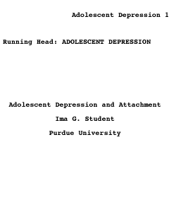
Title Page
Papers in APA style require a title page.
The running head will be used as the header for the whole paper.
Include the paper’s title and the author’s name and affiliation.
Purdue University Writing Lab

Slide 9

APA Style: Two Main Concerns
Reference Page
Parenthetical Citations
Purdue University Writing Lab
Notes:
Rationale: This slide establishes the two areas of APA documentation, the reference page and parenthetical citations.

Slide 10

Reference Page
A list of every source that you make reference to in your essay.
Provides the information necessary for a reader to locate and retrieve any sources cited in your essay.
Each retrievable source cited in the essay must appear on the reference page, and vice versa.
Purdue University Writing Lab
Notes:
Key Concepts: This slide explains the purpose of a reference page. Students may also understand this to be called the “bibliography” page, but APA makes a distinction between the reference page and a bibliography: a reference list “must include only the sources that were used in the research and preparation of the article. Note that a reference list cites works that specifically support a particular article. In contrast, a bibliography cites works for background or for further reading.”
Unlike MLA, APA is only interested in what they call “recoverable data”—that is, data which other people can find. For example, personal communications such as letters, memos, emails, interviews, and telephone coversations should not be included in the reference list since they are not recoverable by other researchers.
The facilitator may stress that each source referenced within the paper should also appear on the reference page. The reference page appears at the end of the paper.

Slide 11
A Sample Reference Page
Purdue University Writing Lab
Notes:
Example: This slide offers students a sample of what a reference page looks like. For this particular paper, titled “Shell Shock and the Great War,”* four sources were used. The first and fourth sources are books with one author. The second source is an article with two authors that appeared in an anthology. The third source is an article that appeared in a continuously paginated journal.
The facilitator may choose to explain the form of this page. The abbreviated title of the paper, “Shell Shock,” appears in the upper right with the page number. “References” should be centered two lines below the abbreviated title. All sources are double spaced and alphabetized according to author. In the past, APA has required that the first line of each entry be indented (like a normal paragraph). But the 5th edition requries a hanging indent in which only the first line of an entry is all the way to the left while subsequent lines are indented.
Notice that titles of books and journals are italicized while titles of articles are neither italicized nor put in quotes. And only the first word of a title and the first word of a subtitle are capitalized.
The facilitator may also choose to reference students to the final pages on the Writing Lab APA handout, which also offers a sample reference.
* From “Shell Shock and the Great War” by Andrew J. Kunka, Purdue University (unpublished manuscript).

Slide 12

Reference Page
Most citations should contain the following basic information:
Author’s name
Title of work
Publication information
Purdue University Writing Lab
Notes:
Rationale: This slide shows the basic information needed for entries on the reference page.

Slide 13
References: Some Examples
Book
Shay, J. (1994). Achilles in Vietnam: Combat trauma and the undoing of character. New York: Touchstone.
Article in a Magazine
Klein, J. (1998, October 5). Dizzy days. The New Yorker, 40-45.
Purdue University Writing Lab
Notes:
Examples: This slide provides examples of a few commonly used citation formats. The facilitator should note that titles of books, magazines, journals, and newspapers should be italicized or underlined.

Slide 14
References: Some Examples
Web page
Poland, D. (1998, October 26). The hot button. Roughcut. Retrieved October 28, 1998 from http://www.roughcut.com
Purdue University Writing Lab
Notes:
Examples: The web page example will prove to be the most confusing for students (particularly because APA just recently released information on citing web pages). According to the manual, “At a minimum, a reference of an Internet source should profice a document title or description, a date (either of publication or update or the date of retrieval), and an address (in Internet terms a URL). Whenever possible, identify the authors of a document as well. If there is no author, begin the entry with the title.

Slide 15
References: Some Examples
A newspaper article
Tommasini, A. (1998, October 27). Master teachers whose artistry glows in private. New York Times, p. B2.
A source with no known author
Cigarette sales fall 30% as California tax rises. (1999, September 14). New York Times, p. A17.
Purdue University Writing Lab
Notes:
Examples: This slide offers examples of citations for a newspaper article and for a source (in this case, a newspaper article) with no author. The facilitator might ask students how to alphabetize a source with no author within a reference page. They should alphabetize according to their next best piece of information--here, the first word of the article, “Cigarette.” When citing a reference in the text, use a short title for the parenthetical citation (e.g., “Cigarette sales”).

Slide 16

Reference Page
What other types of sources might you need to list on your reference page?
Study the basics of APA citation format. When something odd comes up, don’t guess. Look it up!
Purdue University Writing Lab
Notes:
Activity: This slide allows participants a moment to ask questions of the facilitator. If students are working on a research assignment, they may have specific questions that pertain to their own papers. The facilitator may answer questions using the APA Handbook or the APA handout from the Writing Lab.

Slide 17
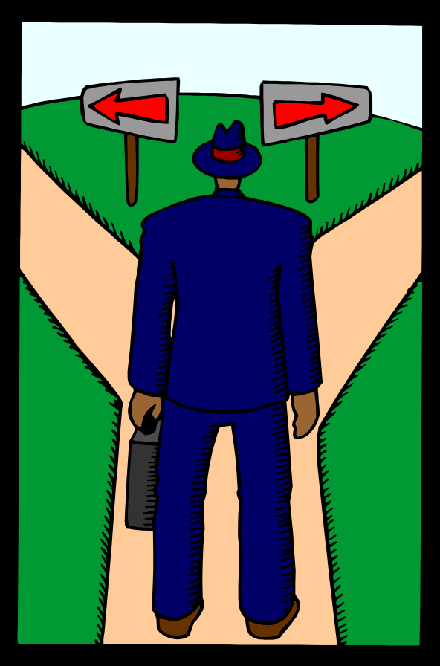
When Should You Use Parenthetical Citations?
When quoting any words that are not your own
  Quoting means to repeat another source word for word, using quotation marks
Purdue University Writing Lab
Notes:
Key Concepts: The next two slides explain the occasions in which APA citations will be necessary, as well as explains the differences between quoting, summarizing, and paraphrasing. Students will be most familiar with the need to site for quotations, but the facilitator should stress that if the idea comes from someone else, the source material should be cited.

Slide 18
When Should You Use Parenthetical Citations?
When summarizing facts and ideas from a source
  Summarizing means to take ideas from a large passage of another source and condense them, using your own words
When paraphrasing a source
  Paraphrasing means to use the ideas from another source but change the phrasing into your own words
Purdue University Writing Lab
Notes:
Key Concepts: This slide explains explains the differences between summarizing and paraphrasing. The facilitator may stress that if the idea comes from someone else, the source material should be cited.
Click to reveal each item.

Slide 19

Keys to Parenthetical Citations
Readability
Keep references brief
Give only information needed to identify the source on your reference page
Do not repeat unnecessary information
Purdue University Writing Lab
Notes:
Key Concepts: This slide emphasizes the need to keep parenthetical citations within a paper brief. The information provided in the body of the paper should be just enough so that a reader could easily cross-reference the citation with its matching entry on the reference page. The following slides give examples of how to use parenthetical references.

Slide 20

Handling Quotes in Your Text
Author’s last name, publication year, and page number(s) of quote must appear in the text
Caruth (1996) states that a traumatic response frequently entails a “delayed, uncontrolled repetitive appearance of hallucinations and other intrusive phenomena” (p.11).
A traumatic response frequently entails a “delayed, uncontrolled repetitive appearance of hallucinations and other intrusive phenomena” (Caruth, 1996, p.11).
Purdue University Writing Lab
Notes:
Examples: The two examples in this slide illustrate methods for including parenthetical citations in the text. If the author’s name is listed in the preceding sentence, only the publication year and page number of the quotation should appear in the parenthetical citation following the sentence. If the author’s name does not appear within the sentence, the parenthetical citation should include the author’s last name, the publication year, and the page number. In either case, a reader should be able to cross-reference back to the reference page and locate all of the publication information needed to find Cathy Caruth’s book:
Caruth, Cathy (1996). Unclaimed experience: trauma, narrative, and history. Baltimore:
Johns Hopkins UP.
Key Concepts: When referring generally to an article or book (rather than to a specific passage) the author should include the last name of the author and the publication year in the parenthetical reference. The facilitator may also note that the parenthetical reference is located before the period.

Slide 21
Handling Parenthetical Citations
Sometimes additional information is necessary . . .
More than one author with the same last name
(H. James, 1878); (W. James, 1880)
Two or more works in the same parentheses
(Caruth, 1996; Fussell, 1975; Showalter, 1997)
Work with six or more authors
(Smith et al, 1998)
Specific part of a source
(Jones, 1995, chap. 2)
Purdue University Writing Lab
Notes:
Examples: This slide demonstrates variations on the parenthetical reference. The first example distinguishes a book by Henry James from a work by William James by including the first initial. The second example distinguishes multiple works within a single citation by dividing them with semi-colons. If a work has six or more authors, as in the third example, the citation should include the words “et al,” meaning “and others.” Finally, if the writer wants to cite a particular section of a work, “chap.” can be added to indicate chapter, and “p.” or “pp.” can be used to indicate page number.

Slide 22

Handling Parenthetical Citations
If the source has no known author, then use an abbreviated version of the title:
Full Title: “California Cigarette Tax Deters Smokers”
Citation: (“California,” 1999)
Purdue University Writing Lab
Notes:
Key Concepts: This slide provides information about additional variations on the parenthetical reference. This example demonstrates how to handle sources with no author. In this case, the newspaper article title is listed in quotation marks.

Slide 23

Handling Parenthetical Citations
A reference to a personal communication:
Source: email message from C. Everett Koop
Citation: (C. E. Koop, personal communication, May 16, 1998)
A general reference to a web site
Source: Purdue University web site
Citation: (http://www.purdue.edu)
Purdue University Writing Lab
Notes:
Examples: The first example illustrates a citation for a personal communication. Personal communication constitutes letters, memos, telephone interviews, and electronic forms of communication (chat rooms and email). Because these sources cannot be cross-checked by outside readers, such sources are only listed in the body of the paper, not on the reference page. The citation should include the the initials and last name of the sources, “personal communication,” and the date of contact.
The second example depicts a citation for a general reference to a web site. If referring to a web site in a general way (no reference to specific passages or information), just the web address should appear in the parenthetical reference. Again, these sources are only listed in the body of the paper, not on the reference page.

Slide 24
Handling Parenthetical Citations
Recently, the history of warfare has been significantly revised by Higonnet et al (1987), Marcus (1989), and Raitt and Tate (1997) to include women’s personal and cultural responses to battle and its resultant traumatic effects. Feminist researchers now concur that “It is no longer true to claim that women's responses to the war have been ignored” (Raitt & Tate, p. 2). Though these studies focus solely on women's experiences, they err by collectively perpetuating the masculine-centered impressions originating in Fussell (1975) and Bergonzi (1996).
However, Tylee (1990) further criticizes Fussell, arguing that his study “treated memory and culture as if they belonged to a sphere beyond the existence of individuals or the control of institutions” (p. 6).
Purdue University Writing Lab
Notes:
Rationale: This slide illustrates the inclusion of APA parenthetical citations within a paper. The facilitator should note that everything should be double spaced consistently.
* From “Shell Shock and the Great War” by Andrew J. Kunka, Purdue University (unpublished manuscript).

Slide 25

Handling Quotes in Your Text
There are many different combinations and variations within APA citation format.
If you run into something unusual, look it up!
Purdue University Writing Lab
Notes:
Rationale: This slide reminds participants that APA reference guides should be consulted to answer questions about parenthetical references or reference page entries.
Activity: At this point, the facilitator may direct students to the sample paper at the end of the APA handout as well as field questions regarding APA documentation.

Slide 26
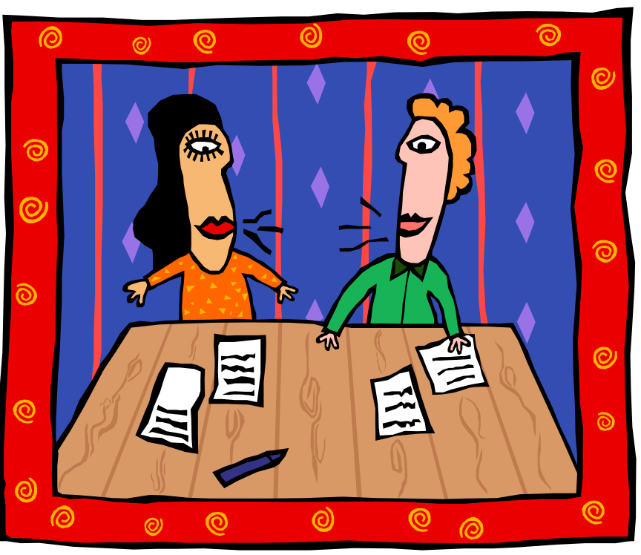
Where can you go for additional help with APA documentation?
Purdue University Writing Lab
Heavilon 226
Grammar Hotline: (765) 494-3723
Check our web site: http://owl.english.purdue.edu
Email brief questions: owl@owl.english.purdue.edu
Purdue University Writing Lab
Purdue University Writing Lab
Notes:
Rationale: As the presentation concludes, the facilitator can remind students that they can come to the Writing Lab for extra help with APA style.
Click mouse after the title question.

